Slide 1
FLImBRUSH data processing

Slide 2
Content
Definition of average lifetime
Determine FLImBRUSH acquisition window
Simulation
FLImBRUSH
Conditional value
Effect of sampling rates
FLImBRUSH system error/imperfections
How to determine alpha value for FLImBRUSH

Slide 3
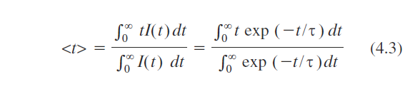
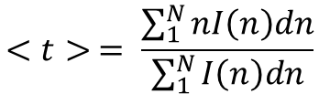
Average lifetime definition
$$<t> = \frac{\sum_{1}^{N}{nI\left(n\right)dn}}{\sum_{1}^{N}{I\left(n\right)dn}}$$
Ideally, the integration is from 0 to infinity
Not possible for physical system
We have to chose a truncation length that minimize the error

Slide 4
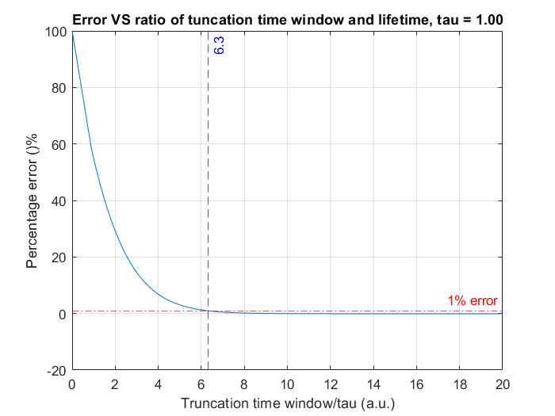
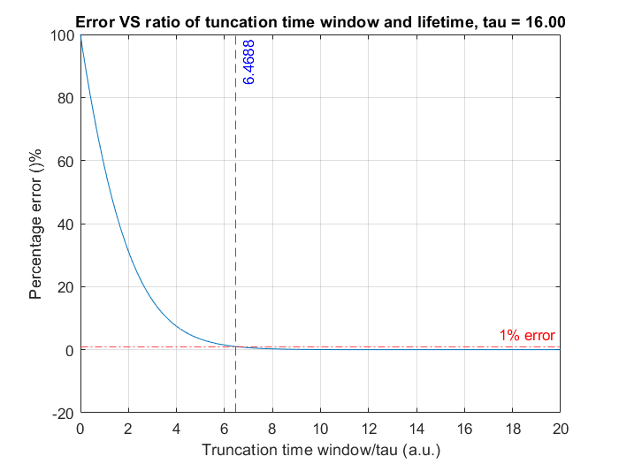
Simulation: single exponential decay
For single exp decay: the acquisition/truncation window should be at least 7 times the lifetime!
Q: True for multi-exponential decay?

Slide 5
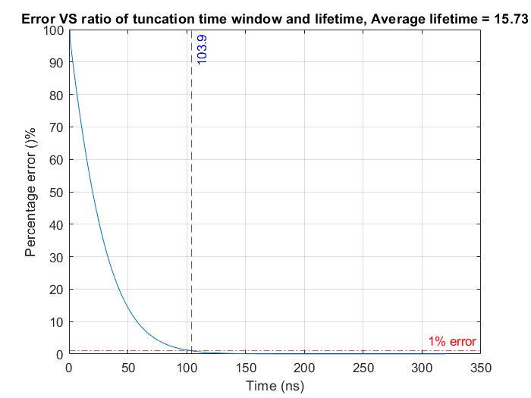
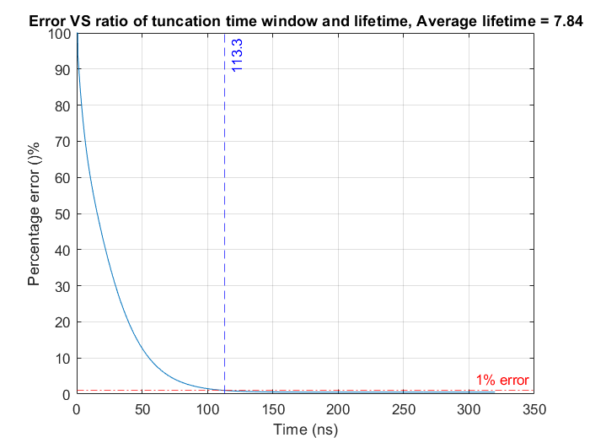
Simulation: double exponential decay
Tau 1 = 3 ns, Tau 2 = 16 ns, a1 = 0.1, a2 = 0.9
Tau 1 = 3 ns, Tau 2 = 16 ns, a1 = 0.9, a2 = 0.1
Ratio = 103.9/15.73 =6.6
Ratio = 113.3/7.84 =14.45
For multi-exponential data, can not use lifetime as a estimation of acquisition/truncation window!

Slide 6
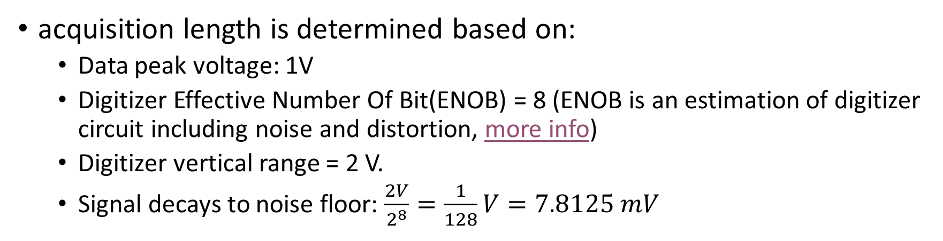
FLImBRUSH
acquisition length is determined based on:
Data peak voltage: 1V
Digitizer Effective Number Of Bit(ENOB) = 8 (ENOB is an estimation of digitizer circuit including noise and distortion, more info)
Digitizer vertical range = 2 V.
Signal decays to noise floor: $\frac{2V}{2^{8}}=\frac{1}{128}V=7.8125 mV$
 | ENOB=7(manual) | ENOB=8 | From measurement data
Noise | 0.0156 | 0.0078 | 0.035

Slide 7
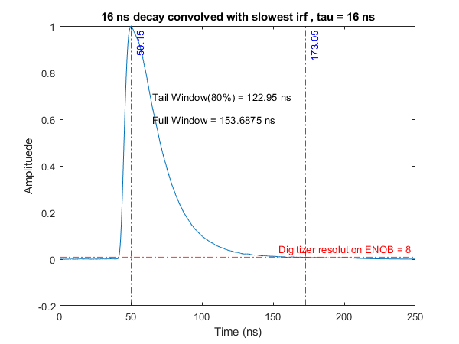
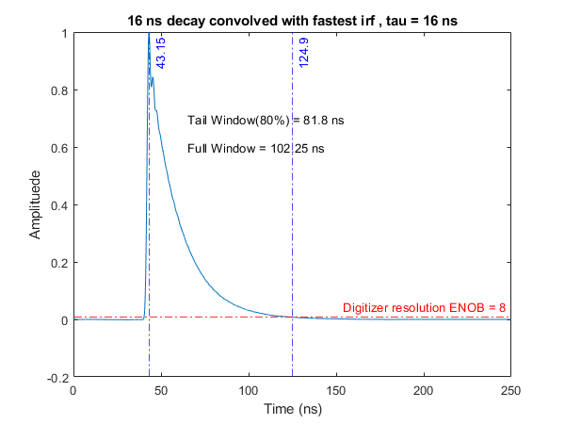
truncation window for PpIX
Simulation setup:
16ns decay
Irf from FLImBRUSH
Assuming 20% before peak, 80% after peak

Slide 8
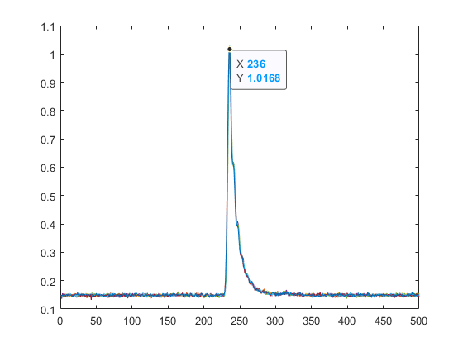
FLImBRUSH acquisition window
Current FLImBRUSH acquisition:
Total: 500 points*0.4 ns/points = 200 ns.
Data after peak: 106 ns (17ns short for slowest iRF).
Solution: We can adjust the trigger delay by 50ns.

Slide 9
Alpha vs Condition value
Sampling rate (GS/s) | Truncation length | Eps = 1.01 | Eps = 1.0001
20 | 3080 | 0.9837 | 0.9808
10 | 1540 | 0.9677 | 0.9619
5 | 770 | 0.9365 | 0.9252
2.5 | 385 | 0.877 | 0.856
We have been using 1.0001 for the past
Simulation:
Lifetime range: 0.3-20ns
Gaussian white noise: 55dB SNR (good approximation for FLImBRUSH)
Truncation window = 154ns (assuming PpIX)

Slide 10
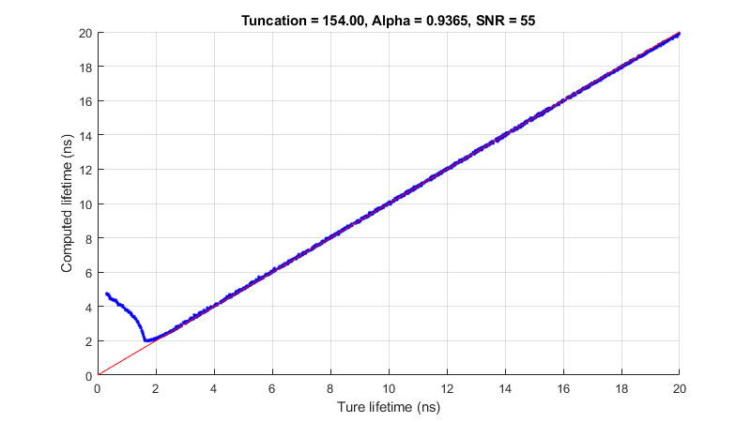

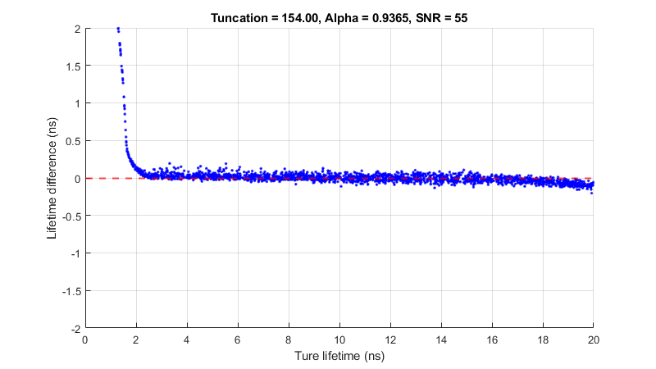
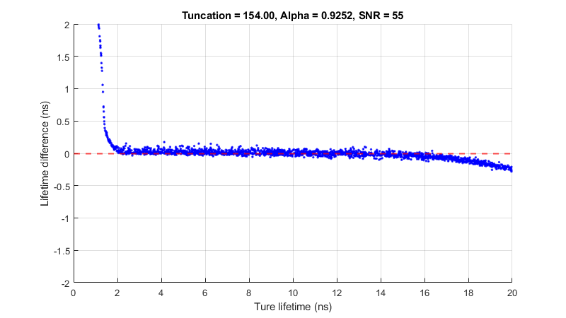
5 GS/s

Slide 11


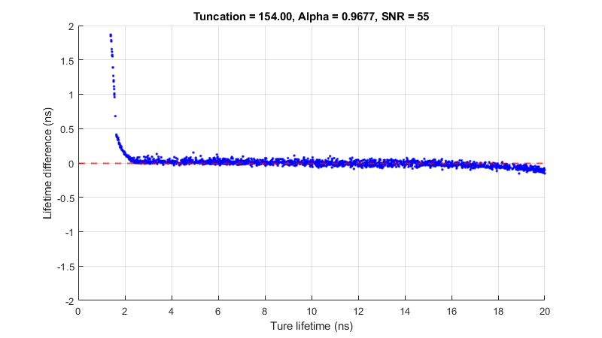
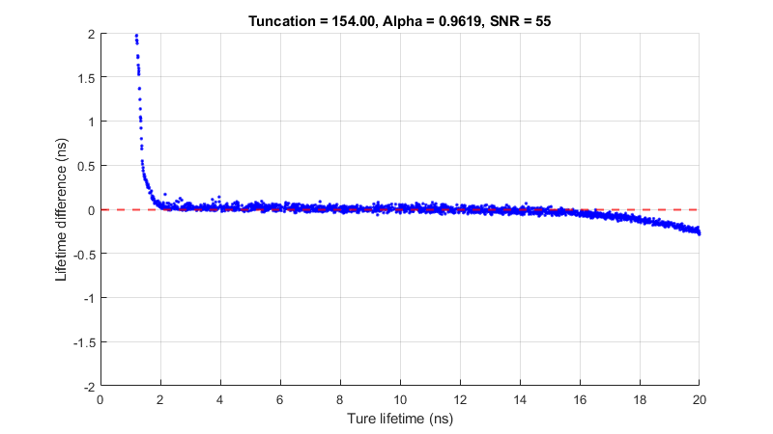
10 GS/s

Slide 12
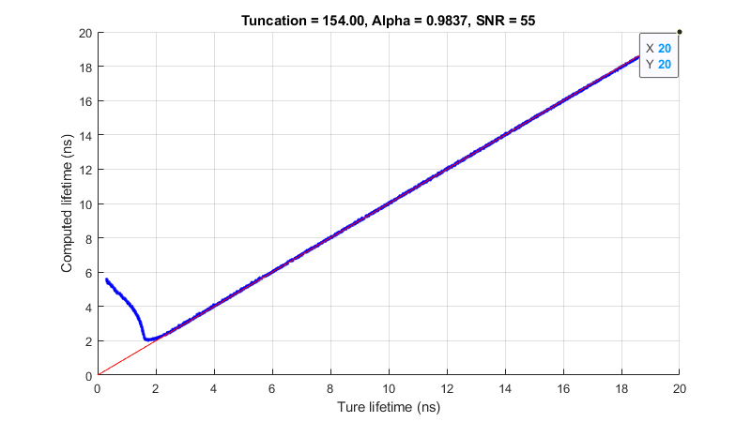

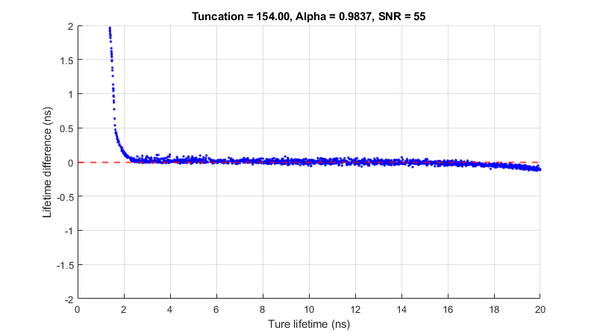
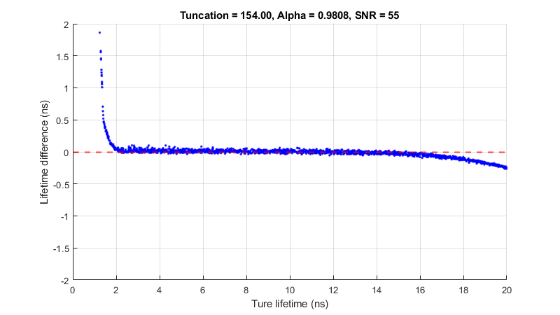
20 GS/s

Slide 13
Summary
The effect of condition value (1.01 vs 1.0001) is minimum. The biggest different is for lifetime > 16ns.
The conditional value just give us a more consistent/convenitent way to estimate alpha.
Under ideal case (0 dc offset, gaussian noise) the larger the alpha, the wider the range of lifetime we can fit.
We will use 1.01 for FLImBRUSH

Slide 14
Effect of up sampling result from dye measurements
2 deconcolution setting:
154ns window(PpIX) with its corresponding alpha
154ns window(PpIX) with alpha corresponding to 54.4ns window (V4)
54.4ns window(matching V4) with its corresponding alpha(see below)
Sampling rate (GS/s) | 154 ns window | 54.4 ns window
5 | 0.9252 | 0.8024
10 | 0.9619 | 0.8958
20 | 0.9808 | 0.9465
Conditional value is 1.0001 here.

Slide 15
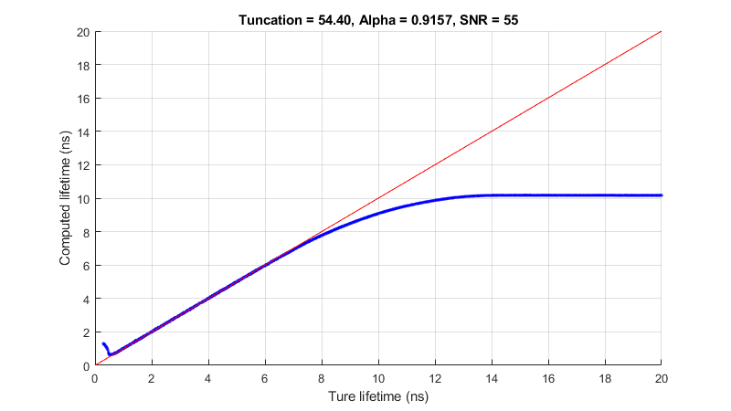
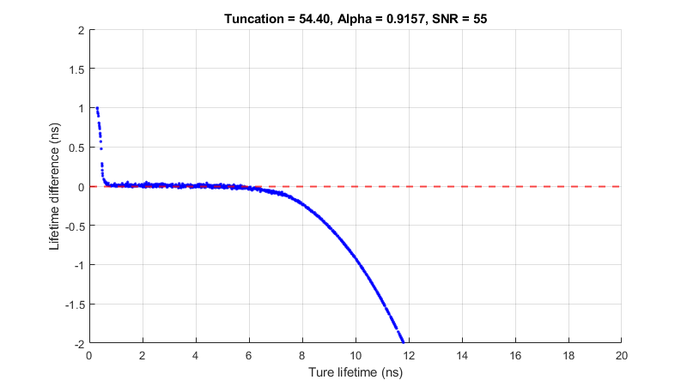
Simulation of lifetime range of V4: 12.5 GS/s, 54.4ns(680 points),alpha = 0.916, single exp decay
V4 is good for lifetime range of ~ 0.5 ns to 6 ns
Notes:
Highlight consistency with FLImBRUSH

Slide 16


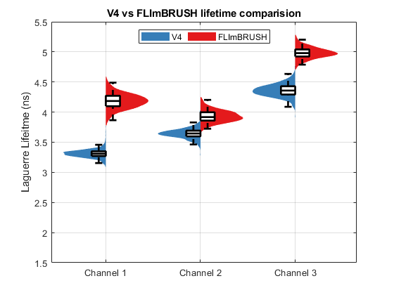
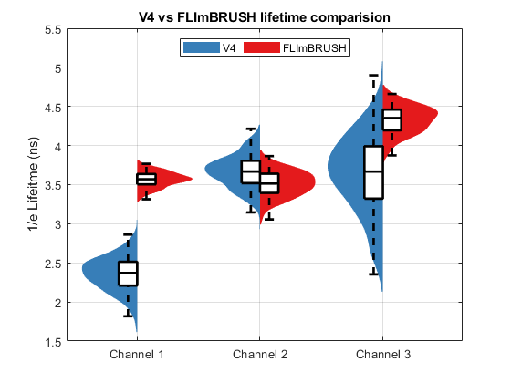
FLImBRUSH: 5 GS/s 154 ns alpha = 0.9252

Slide 17
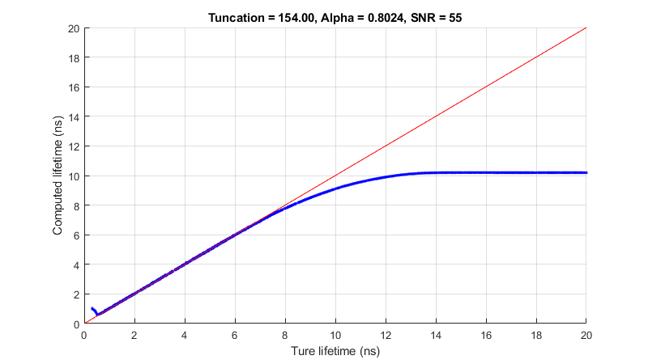
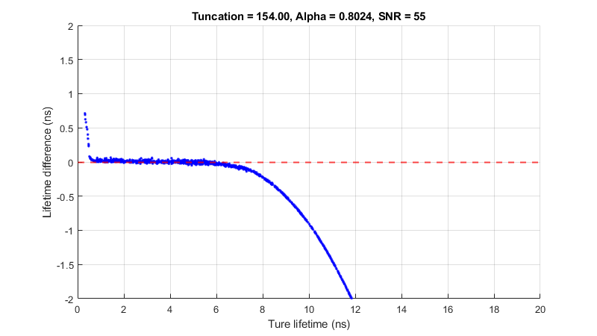
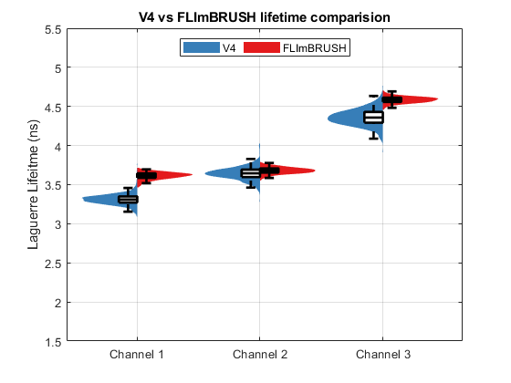
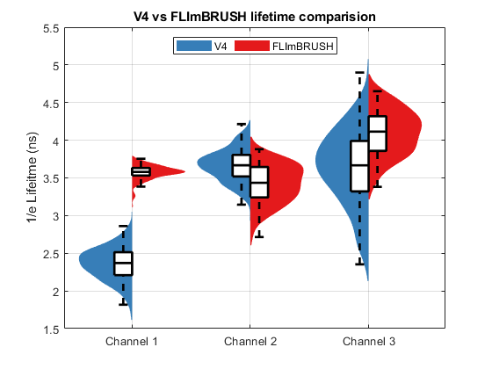
FLImBRUSH: 5 GS/s 154 ns alpha = 0.8024

Slide 18
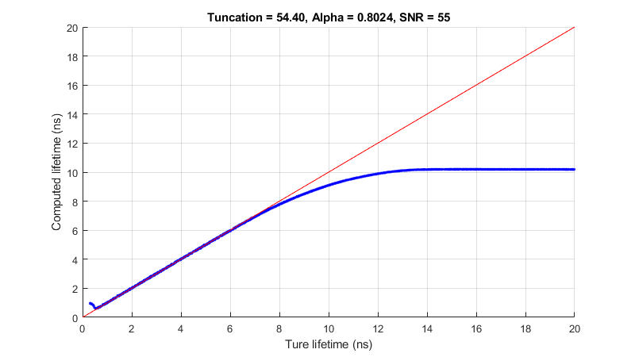
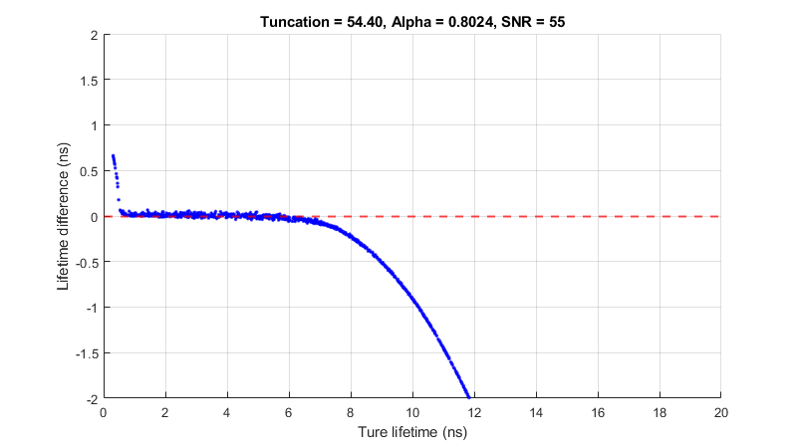
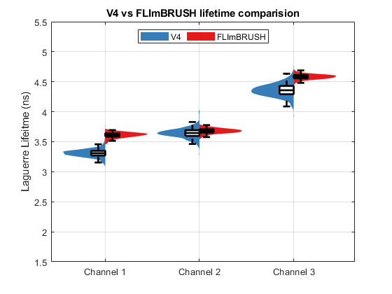
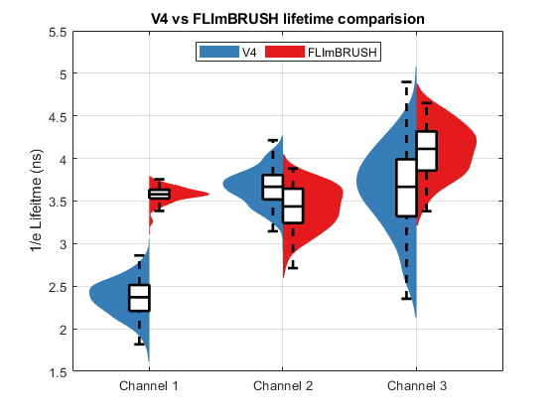
FLImBRUSH: 5 GS/s 54.4 ns alpha = 0.8024

Slide 19
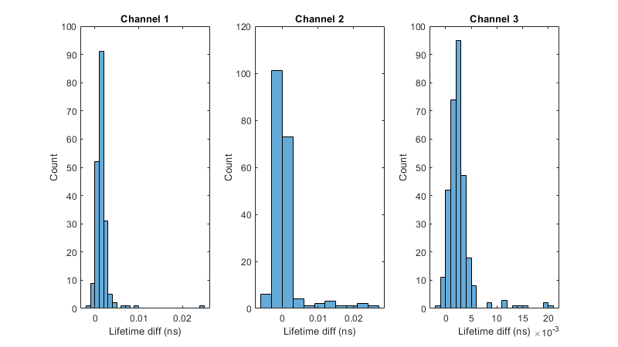
5 GS/s, 54.4 vs 154 ns, alpha = 0.8024
154ns lifetime – 54.4ns lifetime

Slide 20
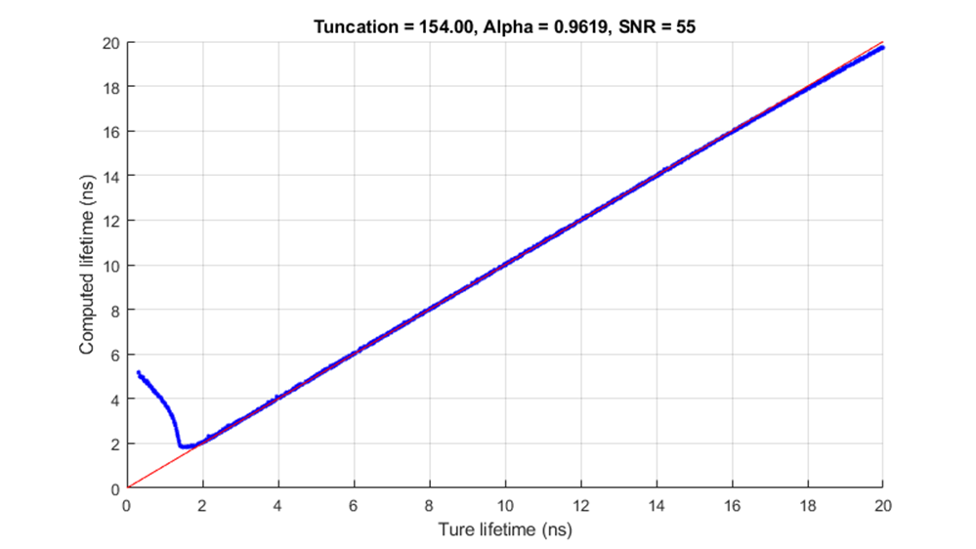
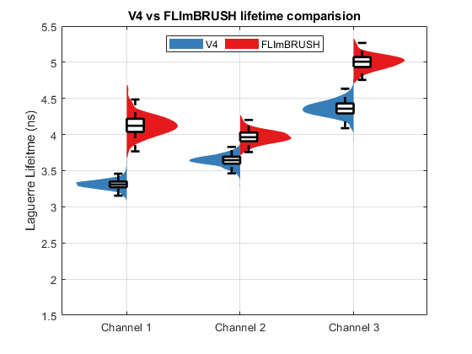
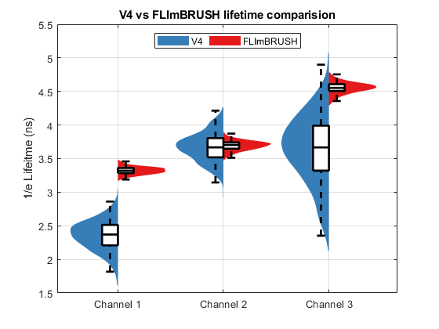
FLImBRUSH: 10 GS/s 154 ns alpha = 0.9619

Slide 21
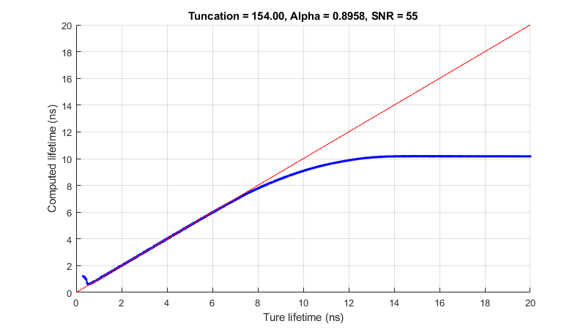
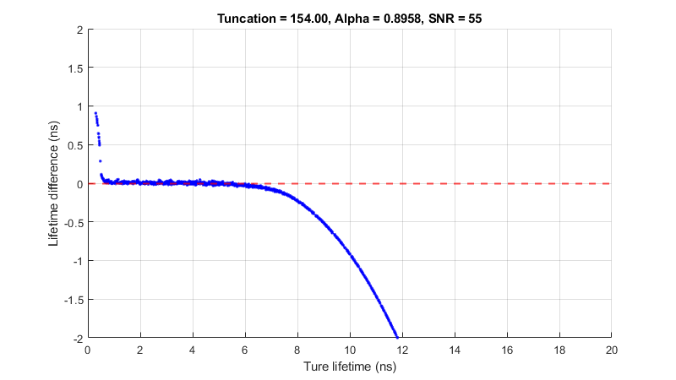
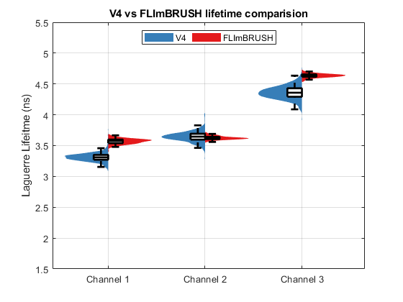
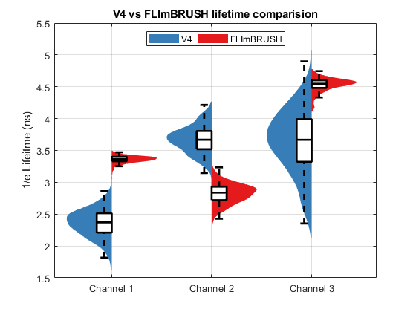
FLImBRUSH: 10 GS/s 154 ns alpha = 0.8958

Slide 22




FLImBRUSH: 10 GS/s 54.4 ns alpha = 0.8958

Slide 23
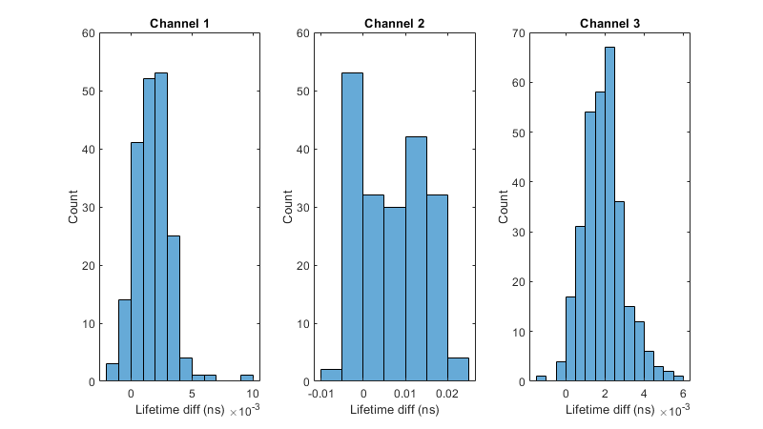
10 GS/s, 54.4 vs 154 ns, alpha = 0.8958
154ns lifetime – 54.4ns lifetime

Slide 24
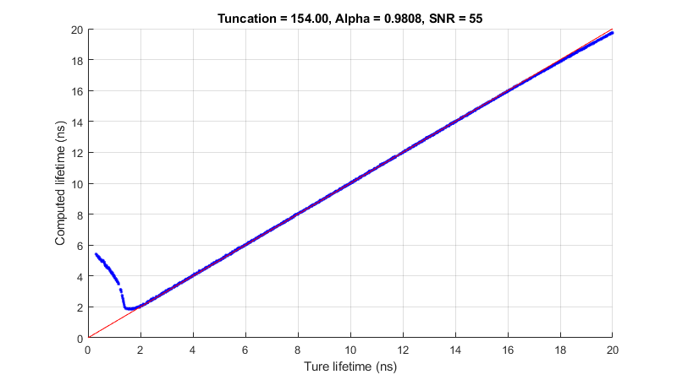

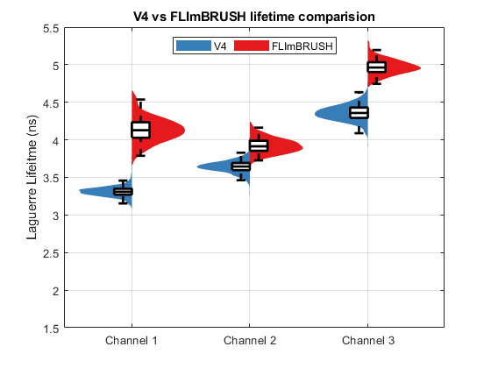
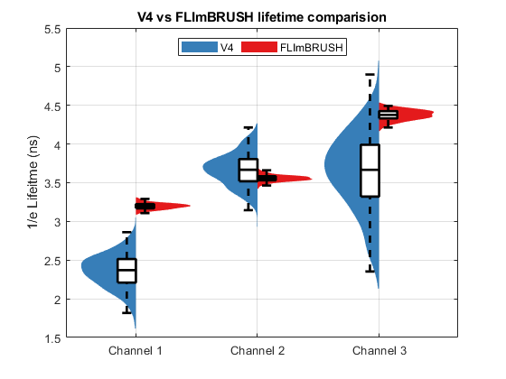
FLImBRUSH: 20 GS/s 154 ns alpha = 0.9808

Slide 25


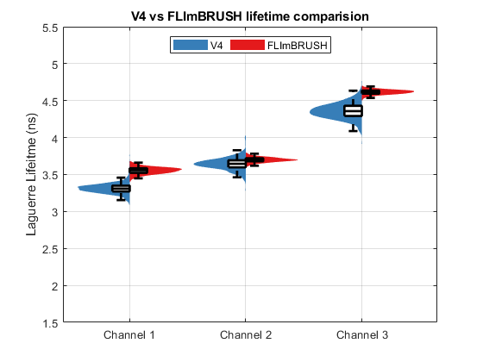
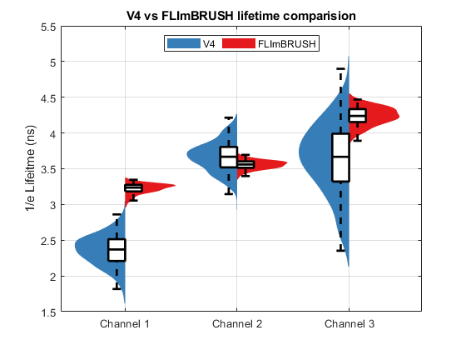
FLImBRUSH: 20 GS/s 154 ns alpha = 0.9465

Slide 26



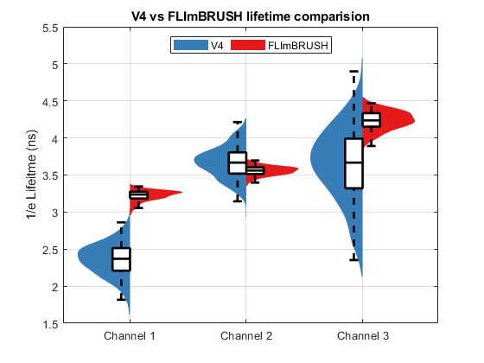
FLImBRUSH: 20 GS/s 54.4 ns alpha = 0.9465

Slide 27
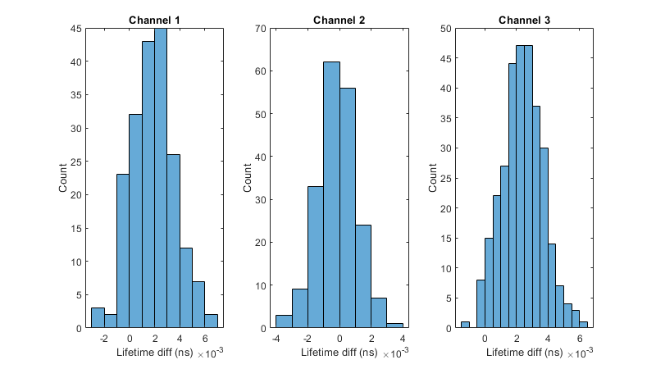
20 GS/s, 54.4 vs 154 ns, alpha = 0. 9465
154ns lifetime – 54.4ns lifetime

Slide 28
Summary
Using maximum alpha (given by conditional value) would give us the largest range of lifetime value we can fit. However, it worsen the std of the data and caused a consistent over estimation of lifetime
No significant improvement of standard deviation using 20 GS/s compared to 10 GS/s
We will use 10 GS/s for FLImBRUSH
Two issues highlighted in red will be explained in the following slide

Slide 29
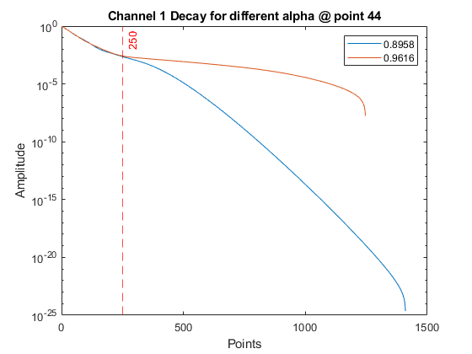
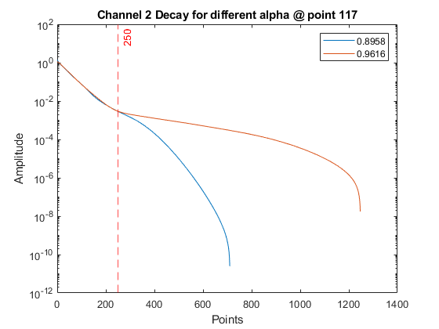
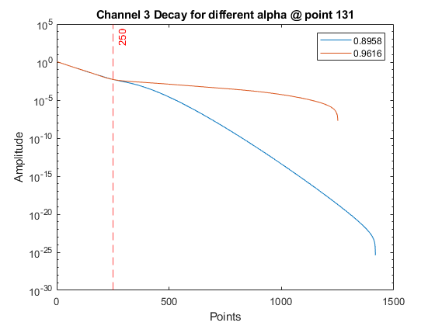
Reconstructed Decays: 10 GS/s 154ns different alpha
The decay always deviate around 250 point(25ns) for all channels
The data have different length because the tail of the data sometime go to very small negative value less than ~-10e-7, which can not be displayed in log scale

Slide 30
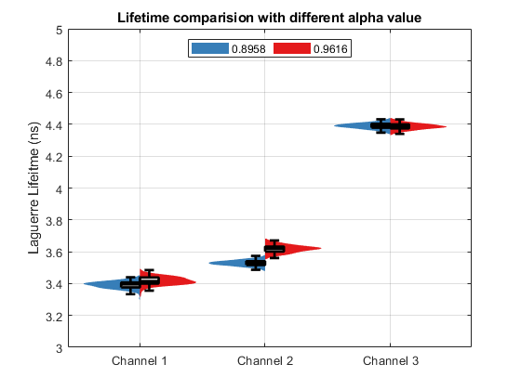
What if we truncate the decays to 250 points (25ns) and compute lifetime?
The lifetime is with in 0.1ns
So something in the tail cause the decay to drag long.

Slide 31


Over estimation of lifetime caused by DC Simulation result
DC = 0
DC = 0.0003
0.0003 DC will cause a overestimation of lifetime by ~0.20 ns for lifetime 2-6 ns

Slide 32

FLImBRUSH DC varies during scan
Subject031_20210804\2021_08_04_neuro031_04_S.mat
Scan duration: 1 min
Points color coded by time(blue is start of the scan, red is end of scan)
The DC value clearly changes as a function of gain and time (likely caused by digitizer temperature)

Slide 33

FLImBRUSH DC estimation
Moving average: use DC from +- 500 waveform (~+-1 in time), and with in gain of +- 5
Red is raw waveform, no averaging
Moving average help with DC estimation.
Notes:
Red is on raw waveforms, regenerate with 4 averaging, compare

Slide 34

FLImBRUSH DC estimation
Moving average: use DC from +- 500 waveform (~+-1 in time), and with in gain of +- 5
Red is averaged WF, 4 averaging

Slide 35

FLImBRUSH DC estimation with moving average

Slide 36


Estimate DC in front vs back
Front = 0.1337
Back = 0.1344
Seems like estimating DC from tail is more accurate.

Slide 37

Histogram of DC different for all waveform

Slide 38

Effect of moving average on lifetime
Moving average helps a bit with std but not much

Slide 39



Signal reflection in data
There is always a big of signal reflection in all channels, around 0.7% of the peak signal

Slide 40


Simulate the reflection, no DC
The reflection of signal causes the overestimation.

Slide 41



Data with reflection removed replaced value 305-350 with average of 325-350, likely lower

Slide 42

Data with reflection removed
Lower lifetime in Ch1&3 likely due to the value used to replace reflection is a bit lower.
The higher std can be expected as shown in the following slides.

Slide 43
Lifetime std vs alpha value simulation
Lifetime 3-20 ns
Truncation window: 154 ns
Signal SNR = 50 dB
Sampling rate: 10 GS/s
Alpha: 0.9619 vs 0.8958

Slide 44


Lifetime std vs alpha value simulation
Using a larger alpha will increase the std of lifetime.

Slide 45

Strategy for FLImBRUSH data processing
Step 1: Rough estimation of lifetime:
154ns truncation window, alpha = 0.9619, with signal reflection, 0 dc offset
Single exp
Lifetime will be over estimated by less than 0.1 ns.

Slide 46

Strategy for FLImBRUSH data processing
Step 2: Accurate estimation of lifetime based on Step 1 using different alpha values.
Lifetime 0.5-6 ns
Single exp
This should cover most of the cases

Slide 47

Strategy for FLImBRUSH data processing
Step 2: Accurate estimation of lifetime based on Step 1 using different alpha values.
Lifetime 1-8 ns
Single exp
At this point, it is just a trade off between lifetime range and std.

Slide 48




double exp simulation parameter
Tau1: 0.3-16 ns
Tau2: 16 ns(PpIX)
Photon ratio (short/long) = 9/1
No DC
No reflection
Laguerre order = 12
Solve linear system for given $a_{1}$and $a_{2}$
$$a_{1}+a_{2}=1$$
$$a_{1}+a_{2}=1$$
$$\frac{a_{1}τ_{1}}{a_{2}τ_{2}}=9$$
$$τ_{1}a_{1}−9τ_{2}a_{2}=0$$

Slide 49

Average lifetime vs tau 1
Average lifetime and tau1 are linearly related.

Slide 50


Lifetime range
True lifetime didn’t tell much about tau 1

Slide 51

Lifetime range vs tau1
The fitting is clearly bad short tau1, how about use lower alpha?

Slide 52

Lifetime range with lower alpha
Use a lower alpha helps but
1. still not good enough if you got NADH
2. Consistent underestimation

Slide 53

with even lower alpha

Slide 54


What if we use more Laguerre functions
Use higher Laguerre order helps but still not good enough for tau1 of 0.5ns

Slide 55


reduce alpha
Boom, that is much better

Slide 56


reduce alpha
Boom, that is much better

Slide 57


Photon ratio = 19, 5% long component
This is done with 0.9400, similar to 0.9475

Slide 58


Photon ratio = 39, 2.5% long component

Slide 59


Photon ratio = 49, 2% long component

Slide 60


Photon ratio = 99, 1% long component

Slide 61
Summary

